Slide 1
Network Scanning Tool
Presented By:
Shubh Patel (210303126042)
Prarthan Christian (210303126058)
Kartikay Mistry (210303126060)
Krenil Raj (210303126010)
Guided By:
Hiren Raithatha
CSE Department
PIET, Parul University
Internal Project Presentation 2024

Slide 2
Overview
In the realm of cybersecurity and network management, the ever-growing complexity of digital landscapes necessitates robust tools for understanding, securing, and optimizing network infrastructures. Our Network Scanning Tool is a sophisticated solution designed to empower administrators and security professionals in comprehensively assessing and managing computer networks.
The tool provides essential functionalities such as Host Discovery and Port Scanning, enabling users to identify networked devices and understand the services running on them. With an emphasis on Service Identification and Vulnerability Assessment, our tool allows for the proactive detection and analysis of potential security risks
Project Presentation 2023

Slide 3
Research Papers studied
Sr. no | Paper Title | Publisher | Year | Take-away points
1. | Difference between Intrusion Detection System (IDS) and Intrusion Prevention System (IPS). [1] | 1 Pune University, Department Computer Science, India 2 Pune university, Department Statistics, India | 2011
2. | Intrusion Prevention/Intrusion Detection System (IPS/IDS) FOR WIFI NETWORKS. [2] | IJCNC | 2014
3. | Network Security Using IDS, IPS & Honeypot International Journal of Recent Research in Mathematics Computer Science and Information Technology. [3] | International Journal of Recent Research in Mathematics Computer Science and Information Technology | 2015
4. | A Survey On Intrusion Detection SystemInformation Technology. [4] | SVITS , IJESDR | 2017

Slide 4
Research Papers studied
Sr. no | Paper Title | Publisher | Year | Take-away points
5. | Intrusion Detection Using Network Monitoring ToolsDepartment of Information TechnologyIndia UIT, RGPV Bhopal (M.P.), IndiaDepartment of Cyber Law & Information TechNLIU, Bhopal (M.P.), India. [5] | Department of Cyber Law & Information TechNLIU, Bhopal (M.P.) , Department of Information TechnologyIndia UIT | 2014
6. | A Network Scanning Detection Method Based on TCP Flow State. [6] | ICSCSE | 2018
7. | Network forensic system for port scanning attack. [7] | IACC | 2010
8. | CANVuS: Context-Aware Network Vulnerability Scanning. [8] | Computer Science & Engineering , University of Michigan | 2019
9. | Port scan detection. [9] | IEEE | 2008

Slide 5
Research Papers studied
Sr. no | Paper Title | Publisher | Year | Take-away points
10. | The application of ICMP protocol in network scanning. [10] | ISPCS | 2003
11. | Anti-Honeypot Technology | IEEE | 2004
12. | A dynamic honeypot design for intrusion detection. [12] | IEEE | 2004
13. | Approaches for Preventing Honeypot Detection and Compromise. [13] | IEEE | 2019
14. | Honey Pot: A Major Technique for Intrusion Detection. [14] | AISC | 2015

Slide 6
Research Papers studied
Sr. no | Paper Title | Publisher | Year | Take-away points
16. | Passive visual fingerprinting of network attack tools. [16] | ACM of Data Mining for Computer Security | 2004
17. | A Novel Data Mining Approach for Analysis and Pattern Recognition of Active Fingerprinting Components. [17] | IEEE | 2019
18. | A Qualitative Survey of Active TCP/IP Fingerprinting Tools and Techniques for Operating Systems Identification. [18] | LNSC | 2018
19. | Remote active OS fingerprinting tool using ICMP. [19] | IEEE | 2006
20. | Active network security. [20] | University of Canterbury | 2001

Slide 7
Objectives of the Project
1. What is exactly to be done?
  Discovery and Enumeration
  Vulnerability Assessment
  OS FingerPrinting
Project Presentation 2024

Slide 8
Objectives of the Project
Why is this project selected?
Why is this project selected?
2. Why is this Project selected?
  Social Impact
  Relevance
  Technological Excellence
3. Where is this project helpful?
  Network Security Assessment
  Policy Compliance
  Security Audits
Project Presentation 2024

Slide 9
Objectives of the Project
4. When it can be implemented?
Authorized Security Assessments
Adequate Resources
5. Who will be benefitted?
System Administrators
Blue Teaming & SOC
Researchers
Project Presentation 2024

Slide 10
Project Team : Roles and Responsibilities
Sr. number | Team member | Enrollment number | Role | Responsibility
1. | Shubh Patel | 210303126042 | Lead Developer (Code Development) | Overall Coordination & Supervision of the project
2. | Prarthan Christian | 210303126058 | Back-End Developer (Code Development) | Handling backend logic of the network scanning tool
3. | Kartikay Mistry | 210303126060 | Model & Design Developer | Designing the User Interface of the tool
4. | Krenil Raj | 210303126010 | Network Coding (Code Development) | Handling Network Protocols , socket programming & data transmission
Project Presentation 2023

Slide 11
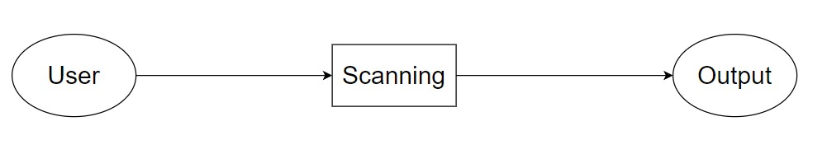
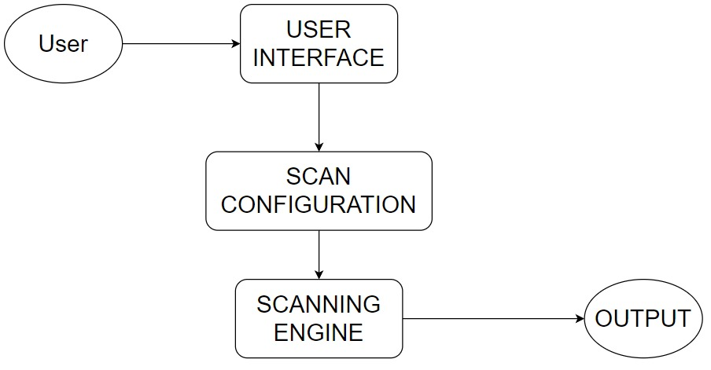
UML Diagrams
Fig-1: DFD 0
Fig-2: DFD1
Project Presentation 2024

Slide 12
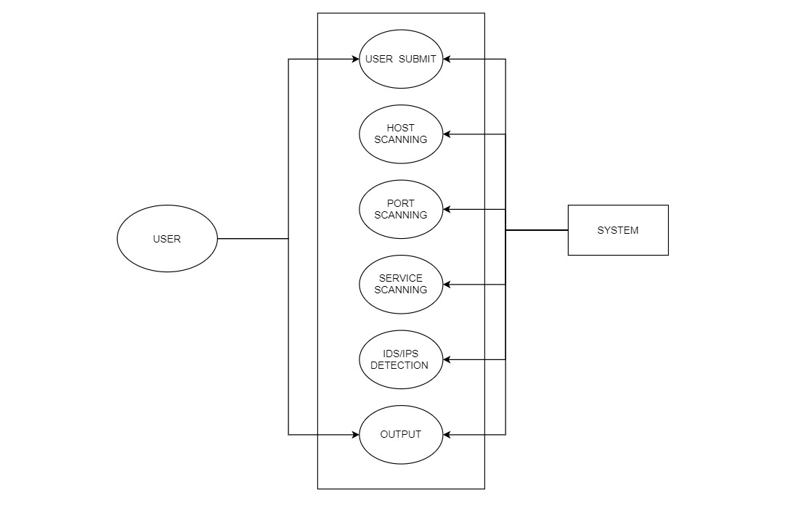
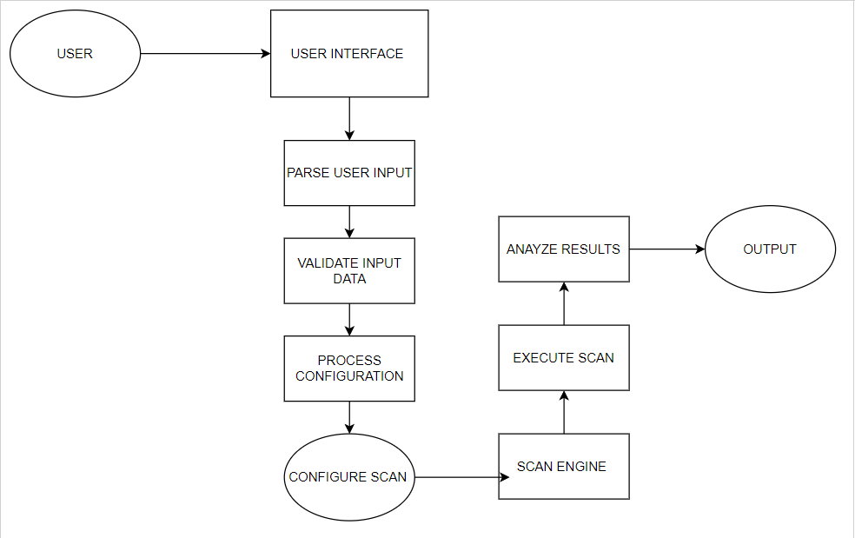
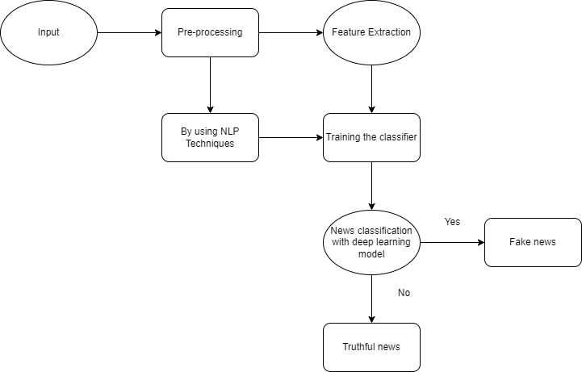
UML Diagrams
Fig-3: DFD 2
Fig-4: Use Case Diagram
Project Presentation 2024

Slide 13
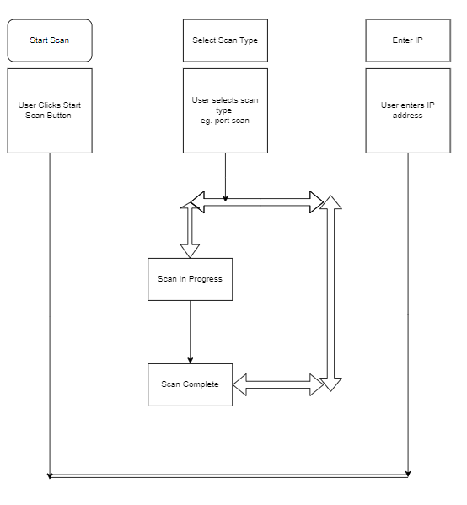
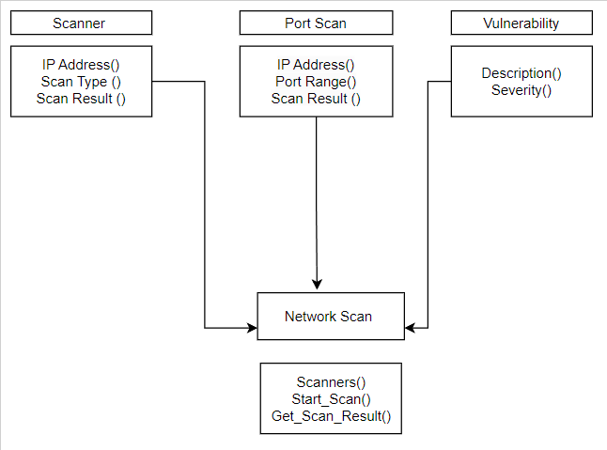
UML Diagrams
Fig-5: Activity Diagram
Fig-6: Class Diagram
Project Presentation 2024

Slide 14
Advantages of the System
Security Assessment
Automation
Compliance
Project Presentation 2024

Slide 15
Limitations of the System
False Positives
Limited Scope
Resource Intensive
Project Presentation 2024

Slide 16
Conclusion
Network scanning tools are valuable assets for organizations seeking to maintain the security and efficiency of their networks. They provide a range of benefits, including security assessment, network monitoring, resource optimization, and compliance support. However, these tools also have limitations, such as false positives, resource intensity, and privacy concerns, which need to be considered when implementing them
Project Presentation 2024

Slide 17
Future Work
GUI Support
Project Presentation 2024

Slide 18
Thank you
Project Presentation 2024

